Slide 1
Handwritten Text Recognition Guide: Dr. Sujan Kumar Saha Kevin Mathew T (BE/10085/17) Aman Kumar (BE/10042/17) Mayank Padia (BE/10298/17) Birla Institute of Technology, Mesra

Slide 2
APPLICATION
Applications
Some of the Applications of this project are:
Notes Extraction from Online Class.
Plagiarism Detection.
Data entry for business documents, e.g. Cheque, passport, invoice, bank statement and receipt.
Make electronic images of printed documents searchable, e.g. Google Books.

Slide 3
INTRODUCTION
Introduction
Recognizing the text in an image has two parts:
01
02
Segmenting the words in the image
Recognition of word in each image
Computer Vision Techniques used
Convolutional-Recurrent Neural Network with CTC Loss used

Slide 4
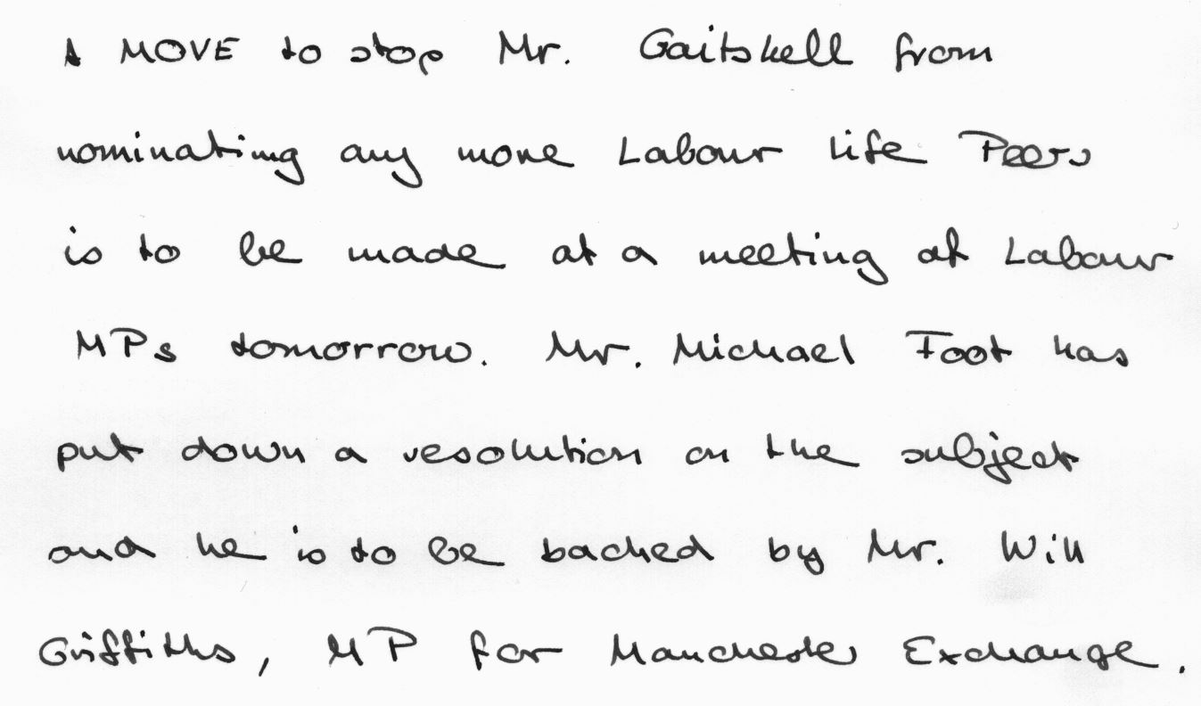
PIPELINE
Word Segmentation Pipeline

Slide 5

PIPELINE
Gaussian Kernel

Slide 6

PIPELINE
Image Binarization

Slide 7
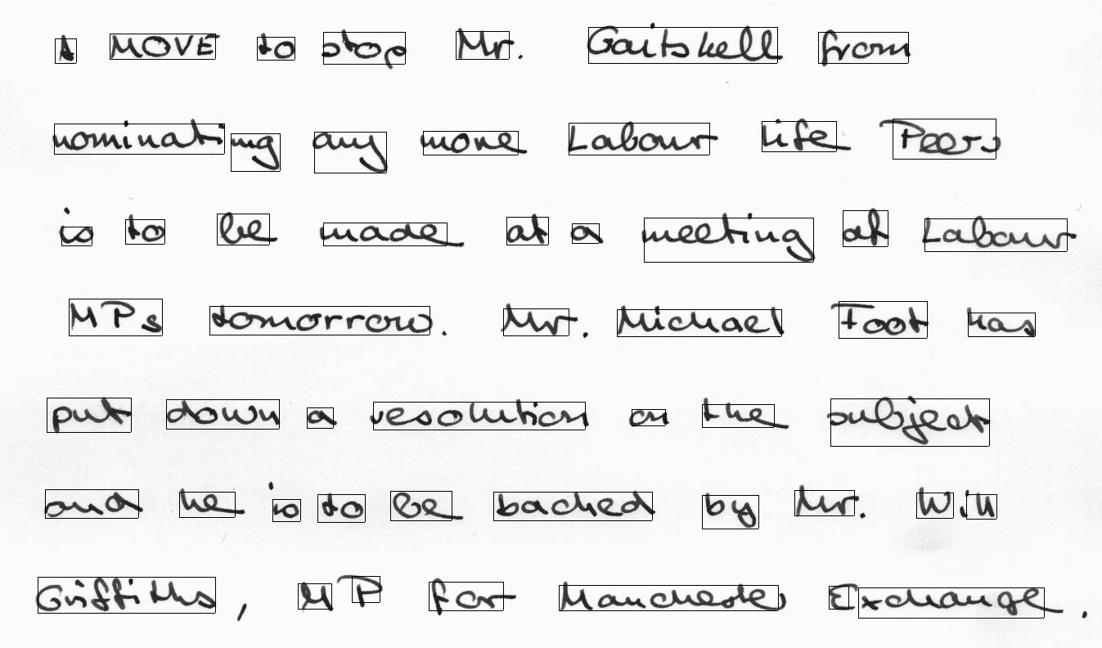
PIPELINE
Extract Connected
Components

Slide 8
PIPELINE

Slide 9

PIPELINE
Deep Learning Model
“Gaitskell”

Slide 10
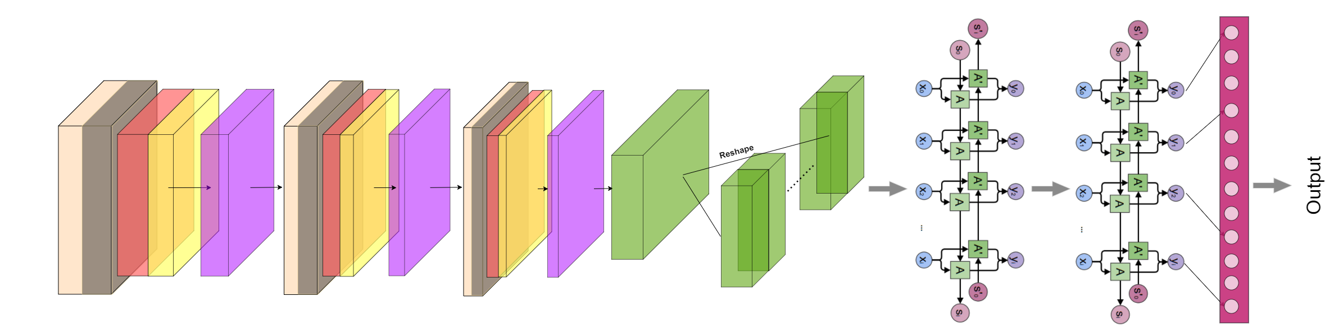
DEEP LEARNING MODEL
Deep Learning Model
Convolutional Recurrent Neural Network

Slide 11
CONVOLUTIONAL NEURAL NETWORK
Convolutional Neural Network
CNN Architecture:
20 Layers.
Convolutional Layers with decreasing kernel size.
Batch Normalization after each Convolutional Layer.
ReLU Activation Used.
MaxPooling of 2x2 after activation is applied.
Dropout did not improve the training process.
Convolutional Layer
Max Pooling Layer

Slide 12
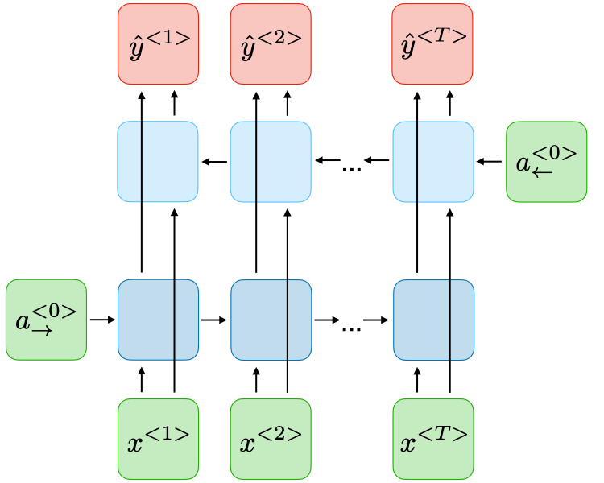
RECURRENT NEURAL NETWORK
Recurrent Neural Network
RNN Architecture:
Bi-LSTM Layer.
2 Layers Deep LSTM.
Softmax Activation.
Again, dropout did not improve the training process.
Bidirectional RNN

Slide 13
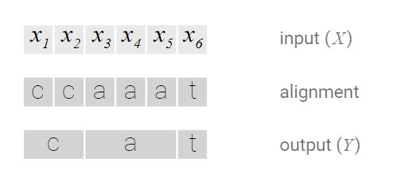
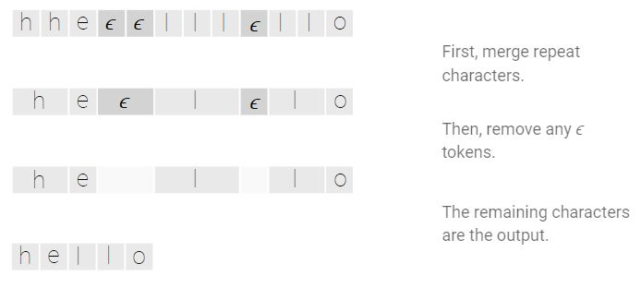
LOSS FUNCTION
Loss Function
Connectionist Temporal Classification Loss

Slide 14
TRAINING PROCESS
Training Process
IAM Dataset – Handwriting Database containing forms of Handwritten English text.
We trained on 92,000 examples (~95%), and we had 4,000 test examples (~5%).
For the word extraction we used OpenCV.
Deep Learning Model was built on PyTorch.
Adam Optimizer with Learning Rate 1e-2.
Learning Rate Scheduler ReduceLROnPlateau.
Batch Size of 32.
Trained for 40 Epochs.
Training took up to 1.5 days, for 40 Epochs, we trained on a NVIDIA GTX-1050 GPU.

Slide 15
DEMONSTRATION
Demonstration

Slide 16
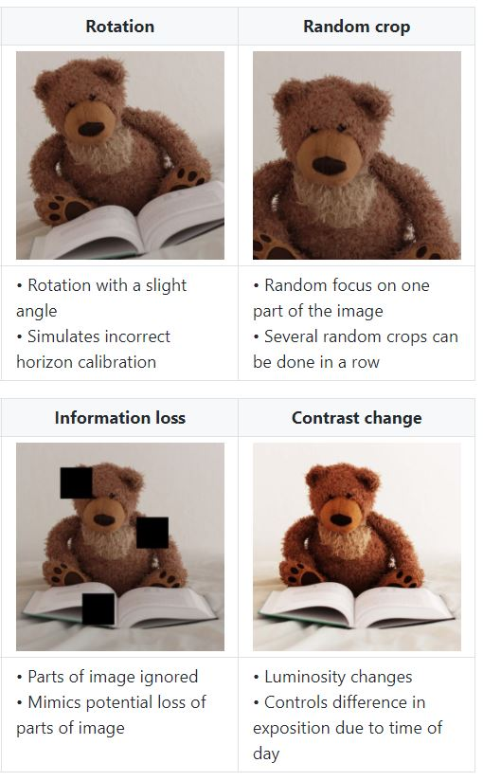
APPLICATIONS
Future Scope & Improvements
Web based application which can help users to write and extract data in read time.
Use Pretrained Models for the CNN.
Use Image Augmentations for training.
Use Deep Learning for word segmentation.
Image Augmentations

Slide 17
REFERENCES
References
Handwritten Text Recognition using Deep Learning - Batuhan Balci, Dan Saadati, Dan Shiferaw (link to paper)
Connectionist Temporal Classification: Labelling Unsegmented Sequence Data with Recurrent Neural Networks – Graves et al. (link to paper)
CTC Loss Explanation (link)
GitHub link to our project: https://github.com/KevinMathewT/HTR-Pytorch

